Slide 1
BITS Pilani
Dr. Lavika Goel
Assistant Professor
Department of CSIS
Pilani Campus

Slide 2
Pilani Campus
CROSS LANGUAGE IR

Slide 3
Today’s Agenda
Cross Language IR
Approaches to Machine Translation(MT)
Classification of MT System
Statistical MT – IBM model1 word based MT
IBM Model 2
IBM Model 3
IBM Model 4
IBM Model 5
Pilani Campus

Slide 4
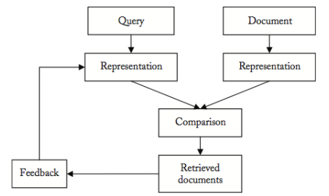
IR in a picture
Pilani Campus

Slide 5
Cross Language IR
Queries and documents are described in different languages. E.g.:
  query: “major earthquakes in recent year”
We want to retrieve both passages below:
  There is a major earthquake in Wenchuan, China in 2008 (EN)
  Un tremblement de terre violent a Wenchuan secoue la Chine en 2008 (FR)
Pilani Campus

Slide 6
Motivations
The relevant document may not exist in the user’s native language
User intend to ﬁnd all the relevant information available, whatever language is used(e.g. searching for patents)
User could be able to read documents in language different from the native one, but could have difﬁculty in formulating queries in those languages
Pilani Campus

Slide 7
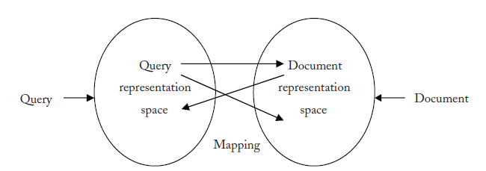
Mapping between representation spaces
In English Computers, Computer, Computing are represented
as Comput after Stemming
Same concept can be represented as different terms in
different languages where the terms are not comparable.
Key issue in CLIR is to develop tools that match terms in
different languages having same meaning.
Pilani Campus

Slide 8
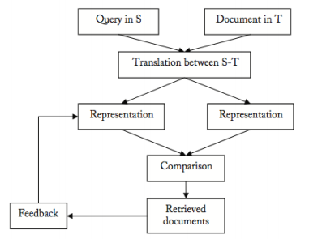
CLIR in a picture
Pilani Campus

Slide 9
Mapping / Translation process
The Translations can be used in several ways
Mapping the document representation into the query representation space: document translation
Mapping the Query representation into the document representation space: Query translation
Mapping the both document and query representations into third space.
Pilani Campus
Notes:
The translation module could use one of the following approaches:
Document translation Mapping the document representation into the query rep.
• Pro: more context but current MT systems don’t exploit the context much
• Contra: one has to determine in advance to which language each document
should be translated, all the translated versions should be stored.
Query translation Mapping the query representation into the document representation
• Pro: flexible, more interaction with the user (who could choose the languages
of interest, can correct the translation.)
• Contra: translation ambiguity amplified by the lack of context.
Inter-lingua translation Mapping document and query representation to a 3rd language
• Pro: useful if there is no resource for a direct translation.
• Contra: lower performance that the direct translation
Most used approach in CLIR: Query translation

Slide 10
The translation module
Query translation Mapping the query representation into the document representation
  Pro: ﬂexible, more interaction with the user (who could choose the languages of interest, can correct the translation.)
  Contra: translation ambiguity ampliﬁed by the lack of context.
Document translation Mapping the document representation into the query rep.
  Pro: more context but current MT systems don’t exploit the context much
  Contra: one has to determine in advance to which language each document should be translated, all the translated versions should be stored.
Inter-lingua translation Mapping document and query representation to a 3rd language
  Pro: useful if there is no resource for a direct translation.
  Contra: lower performance that the direct translation
Most used approach in CLIR: Query translation
Pilani Campus

Slide 11
Companies & CLIR
2006 Yahoo!: translates queries in French and German to English, Spanish, Italian and French/German
2007 Google: searching without boundaries
here: CLS (Cross Library Service)
Pilani Campus

Slide 12
Basic terminology
A bitext is a pair of texts such that one is a translation of the other.
A tritext is a triple of texts such that they are each a translation of the others.
Parallel corpora include bitexts, tritexts, and any set of N texts, such that each is a translation of the others.
Parallel corpora tend towards literal translations(word-for-word translation).
Pilani Campus
Notes:
In the field of translation studies a bitext is a merged document composed of both source- and target-language versions of a given text.
Bitexts are generated by a piece of software called an alignment tool, or a bitext tool, which automatically aligns the original and translated versions of the same text. The tool generally matches these two texts sentence by sentence. A collection of bitexts is called a bitext database or a bilingual corpus, and can be consulted with a search tool.

Slide 13
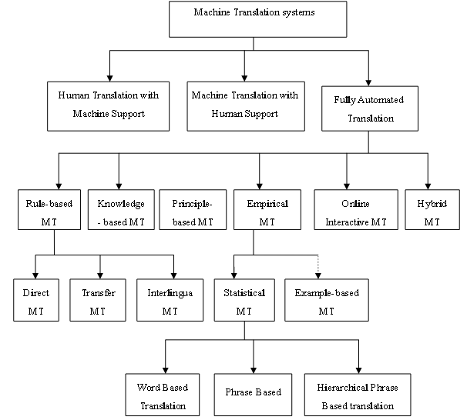
Classification of MT System
Pilani Campus

Slide 14
Statistical MT
Statistical MT relies on translation examples contained in a parallel corpus, i.e., a set of texts translated into another language.
Such a corpus can be further processed into aligned sentences
Word-to-word translation
Phrase-based translation
Syntax-based translation (tree-to-tree, tree-to-string)
Trained on parallel corpora
Usually noisy-channel (at least in spirit)
Pilani Campus

Slide 15
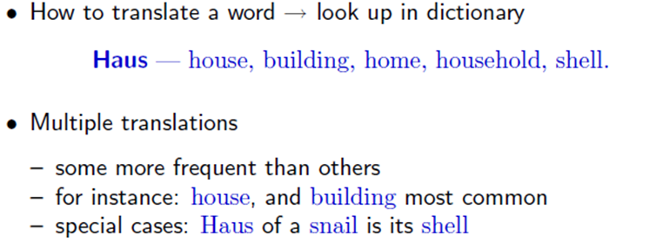
Word-based models
Lexical Translation
Pilani Campus

Slide 16
Formulating the problem
Input is the Source language: f(Foreign)
Output is the Target language: e(English)
Foreign text (F)
English text (E)
Many possible translations from F – E
T1
We can model these differences of opinion with a probability distribution P(E|F) over possible translations, E, given that the Foreign text was F.
A reasonable way of choosing the “best” translation is to choose which maximizes the conditional probability P(E|F)
T2
different opinions
From F - E
.
.
Tn
unknown
Pilani Campus
Notes:
We will try to create English sentences e that best represent foreign sentence f.
http://michaelnielsen.org/blog/introduction-to-statistical-machine-translation/

Slide 17
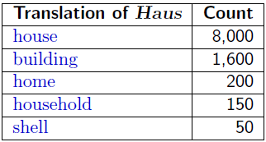
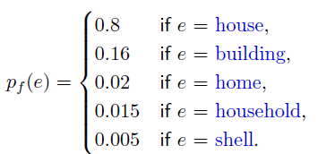
Collect Statistics
Look at a parallel corpus (German text along with English translation)
10,000 occurrences of the word Haus
Estimate Translation Probabilities
Maximum likelihood estimation
Pilani Campus

Slide 18
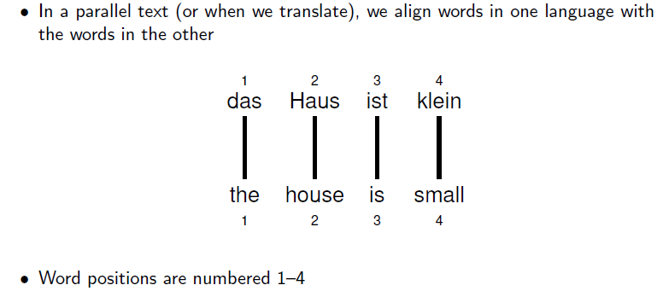
Alignment
Pilani Campus

Slide 19
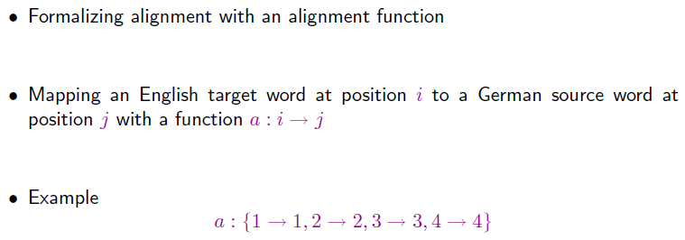
Alignment Function
Pilani Campus

Slide 20
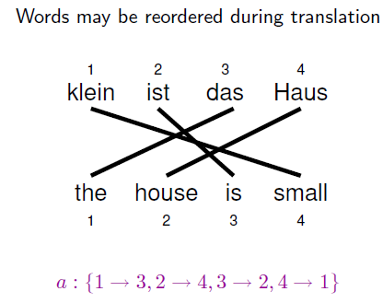
Reordering
Pilani Campus

Slide 21
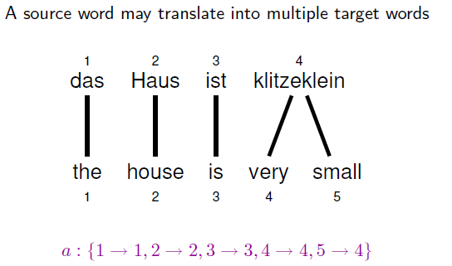
One-to-Many Translation
Pilani Campus
Notes:
http://videolectures.net/hltss2010_eisner_plm/
http://videolectures.net/clspss09_lopez_mt/
http://michaelnielsen.org/blog/introduction-to-statistical-machine-translation/

Slide 22
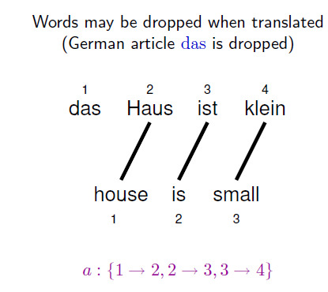
Dropping Words
Pilani Campus

Slide 23
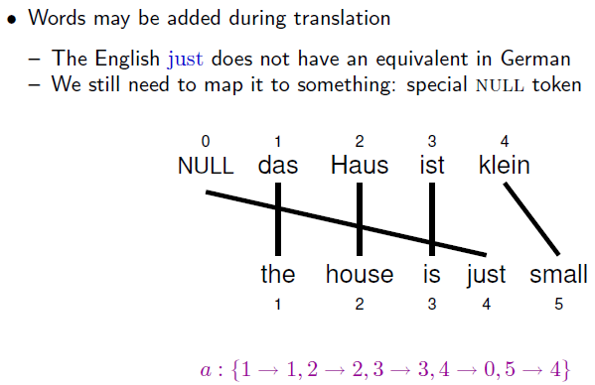
Inserting Words
Pilani Campus

Slide 24
IBM Model 1
How do we model P(e|f)?
English sentence e has m words e₁,e₂..e_{m}
Foreign sentence f has l words f₁,f₂..f_{l}
An alignment a identifies which English word each foreign word is originated from?
Formally an alignment a is {a₁,,a₂…a_{m}} where each
a_{j} Є {0.. l}
There are (l+1)^{m} possible alignments
Pilani Campus

Slide 25
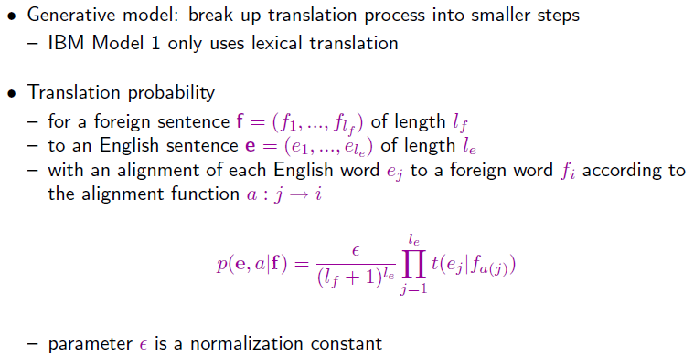

IBM Model 1
Input is the Source language: f(Foreign)
Output is the Target language: e(English)
Product over all words in English sentence
normalization
lexical translation probabilities for all l_{e}
generated output words e_{j}
No of alignments possible (l_{f}+1)^{le}
Pilani Campus
Notes:
T(e_{j}|f_{a(j)}) each of these English words are assumed to come from some foreign word. Which foreign word it came from? It came from the j^{th} foreign word it is aligned with.

Slide 26
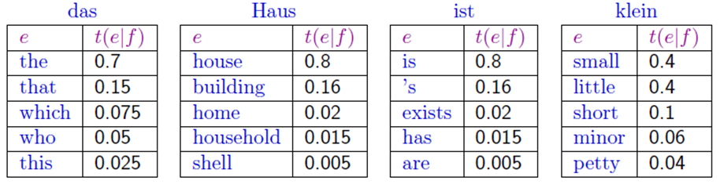
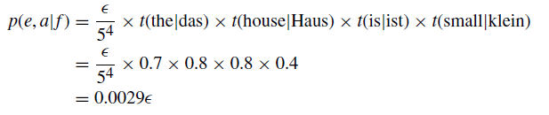
Example
Translation score
if we know the parameters t for this Translation model
Pilani Campus

Slide 27
IBM Model 1 and EM
EM Algorithm consists of two steps
Expectation-Step: Apply model to the data
  parts of the model are hidden (here: alignments)
  using the model(given alignments), assign probabilities to possible values
Maximization-Step: Estimate model from data
  take assign values as fact
  collect counts (weighted by probabilities)
  estimate model from counts
Iterate these steps until convergence
Output:
Alignments
Pilani Campus

Slide 28
IBM Model 1 and EM
We need to be able to compute:
Expectation-Step: probability of alignments
Maximization-Step: count collection (Counting up how many times the words get alignment to each other)
Pilani Campus

Slide 29
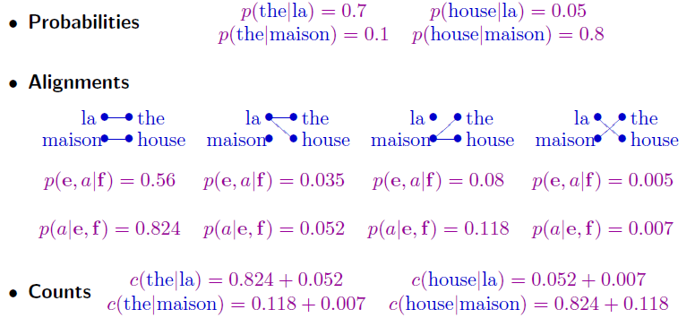
IBM Model 1 and EM
Given some initial word translation probabilities
we can compute the probability of alignment
What is the probability of alignment where the was aligned to la
Given probability of alignments we can compute the expected count
Pilani Campus

Slide 30
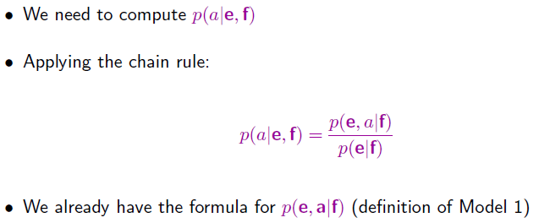
IBM Model 1 and EM: Expectation Step
Compute the probability of an alignment given a complete English Foreign Sentence pair.
P(e,a|f) probability of English sentences and alignment given a foreign sentence
So we need to compute the probability of english string given a foreign string p(e|f)
Pilani Campus

Slide 31
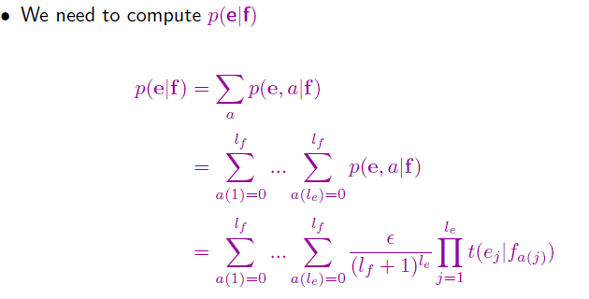
IBM Model 1 and EM: Expectation Step
Marginalize over all the alignments
For every alignment
For every word in e aligned to f
Definition of IBM model -1
Pilani Campus

Slide 32
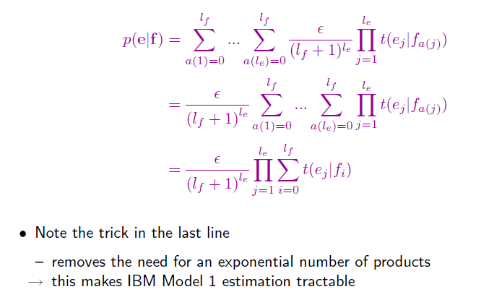
IBM Model 1 and EM: Expectation Step
Probability of an alignment is constant
Messy sums and then a product
Sum over products
products over Sum
Pilani Campus

Slide 33
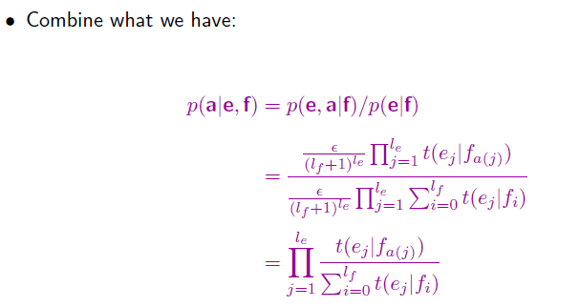
IBM Model 1 and EM: Expectation Step
Combining the definition of model 1 with the marginalized Probability
The probability of an alignment is nothing but probability of the translations given the alignment.
Pilani Campus

Slide 34
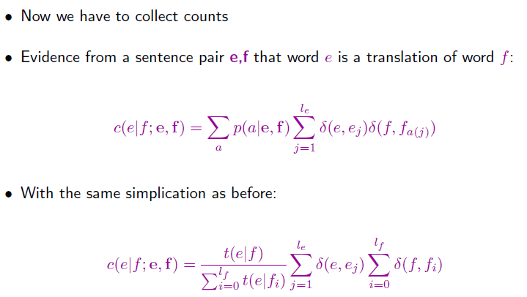
IBM Model 1 and EM: Maximization Step
count where single word in e is translated from the single foreign word f given the
English sentence e and foreign sentence f.
Sum over all possible alignments
No. of times the English word e was
Aligned with foreign word f in that alignment
Pilani Campus

Slide 35
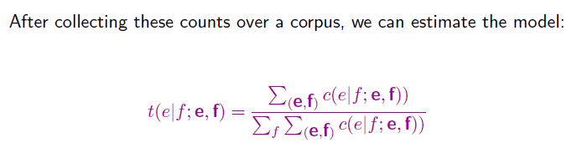
IBM Model 1 and EM: Maximization Step
The probability of translating English word e from foreign word f just summing over
all sentences in the corpus
Pilani Campus

Slide 36
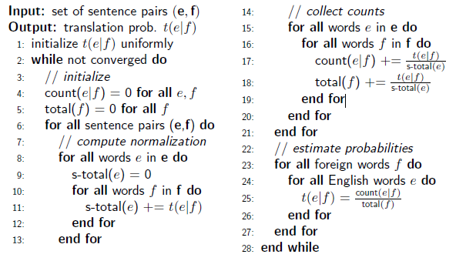
IBM Model 1 and EM: Pseudocode
Pilani Campus

Slide 37
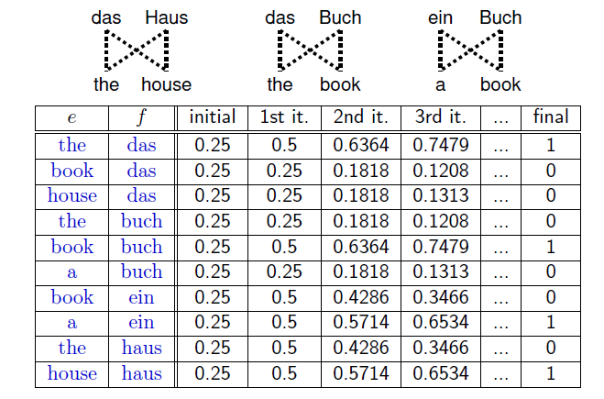
Convergence
Pilani Campus

Slide 38
Exercise
Consider the following sentences as parallel corpus
Sentence 1:
f1: kutta bhouka
e1: dog barked
Sentence 2:
f2: kutta kaata
e2: dog bit
Pilani Campus

Slide 39
Exercise (contd..)
Step 1 – Initialization: Set all translation parameters uniformly
Since there are 3 English words all p(e|f) is set to 1/3.
Step 2 – Alignments: compute p(a,e|f) and p(a|e,f)
S1 can be generated using the following 4 different alignments:
a1={<0,0><1,0>} a2={<0,1><1,1>} a3={<0,0><1,1>} a4={<1,0><0,1>}
Each p(a,e|f) can be generated with a probability for ex. a1 can be computed
by p(0|0) X p(1|0) = p(dog|kutta) X p(barked|kutta) = 1/3X1/3 = 1/9
a1=1/9,a2=1/9,a3=1/9,a4=1/9
p(dog|kutta) = 1/3 | p(bit|kutta) = 1/3 | p(barked|kutta) = 1/3
p(dog|bhouka) = 1/3 | p(bit|bhouka) = 1/3 | p(barked|bhouka) = 1/3
p(dog|kata) = 1/3 | p(bit|kata) = 1/3 | p(barked|kata) = 1/3
Pilani Campus

Slide 40
Exercise (contd..)
S2 can be generated using the following 4 different alignments:
a1={<0,0><1,0>} a2={<0,1><1,1>} a3={<0,0><1,1>} a4={<1,0><0,1>}
Each p(a,e|f) can be generated with a probability for ex. a1 can be computed by p(0|0) X p(1|0) = p(dog|kutta) X p(bit|kutta) = 1/3X1/3 = 1/9
a1=1/9,a2=1/9,a3=1/9,a4=1/9
Pilani Campus

Slide 41
Exercise (contd..)
Step3:Compute p(a|e,f) for each alignment normalize the values
S1
a1=1/9 p(a1|e,f) = (1/9)/1/9+1/9+1/9+1/9 = 1/4
a2=1/9 p(a2|e,f) = (1/9)/1/9+1/9+1/9+1/9 = 1/4
a3=1/9 p(a3|e,f) = (1/9)/1/9+1/9+1/9+1/9 = 1/4
a4=1/9 p(a4|e,f) = (1/9)/1/9+1/9+1/9+1/9 = 1/4
S2
a1=1/9 p(a1|e,f) = (1/9)/1/9+1/9+1/9+1/9 = 1/4
a2=1/9 p(a2|e,f) = (1/9)/1/9+1/9+1/9+1/9 = 1/4
a3=1/9 p(a3|e,f) = (1/9)/1/9+1/9+1/9+1/9 = 1/4
a4=1/9 p(a4|e,f) = (1/9)/1/9+1/9+1/9+1/9 = 1/4
Pilani Campus

Slide 42
Exercise (contd..)
Step4:Take the counts for each translations over the whole corpus i.e observe in the whole corpus how many times each words have been aligned and add their p(a|e,f)
Step5:Normalize fractional counts to get revised parameter values
Note: Correct translation probabilities increase for ex dog, kutta from the initial uniform probability
c(dog|kutta) = 1 | c(bit|kutta) = 1/2 | c(barked|kutta) = 1/2
c(dog|bhouka) = 1/2 | c(bit|bhouka) = 0 | c(barked|bhouka) = 1/2
c(dog|kata) = 1/2 | c(bit|kata) = 1/2 | c(barked|kata) = 0
c(dog|kutta) = 0.5 | c(bit|kutta) = 0.25 | c(barked|kutta) = 0.25
c(dog|bhouka) = 1/2 | c(bit|bhouka) = 0 | c(barked|bhouka) = 1/2
c(dog|kata) = 1/2 | c(bit|kata) = 1/2 | c(barked|kata) = 0
Pilani Campus

Slide 43
Exercise (contd..)
Repeat from step 2-5 until convergence
for ex after 5 iterations
p(dog|kutta) = 0.9999
p(bit|kutta) = 0.0001
p(barked|kutta) = 0.0001
p(dog|bhouka) = 0.0001
p(bit|bhouka) = 0.0001
p(barked|bhouka) = 0.9999
p(dog|kata) = 0.0001
p(bit|kata) = 0.9999
p(barked|kata) = 0.0001
Pilani Campus

Slide 44
Pilani Campus
IBM Higher models for Machine Translation
Pilani Campus

Slide 45
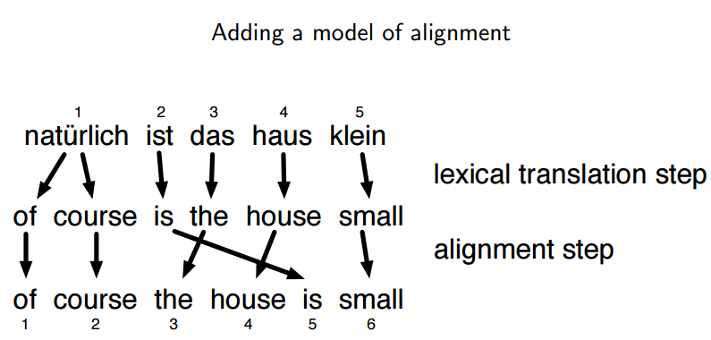
IBM Model 2
Pilani Campus

Slide 46
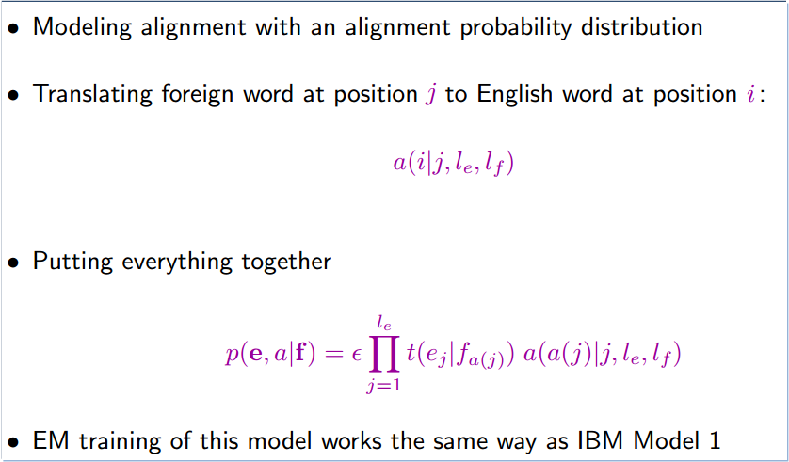
IBM Model 2
Index in english word
Index in foreign word
Index in english word
Index in foreign word
Joint probability of e, a conditioned on f
Joint probability of e, a conditioned on f
Pilani Campus

Slide 47
Example
l_{f}=5 and l_{e}=6
F = w1 w2 w3 w4 w5
E= and the program has been implemented
P(a|e,f) = a(1|1,6,5) X
a(2|1,6,5) X
a(3|2,6,5) X
a(4|3,6,5) X
a(5|4,6,5) X
a(6|5,6,5) X
The product of these terms gives the probability.
This alignment conditioned on English sentence
and length of the foreign sentence.
Pilani Campus

Slide 48

IBM Model 2
Given a sentence pairs e1,e2,,..,e_{le} ; f1,f2,f3,…,f_{lf}
a_{j} = argmax
aЄ{0,..l}
for j=1..lf
F = w1 w2 w3 w4 w5
E= and the program has been implemented
Pilani Campus

Slide 49
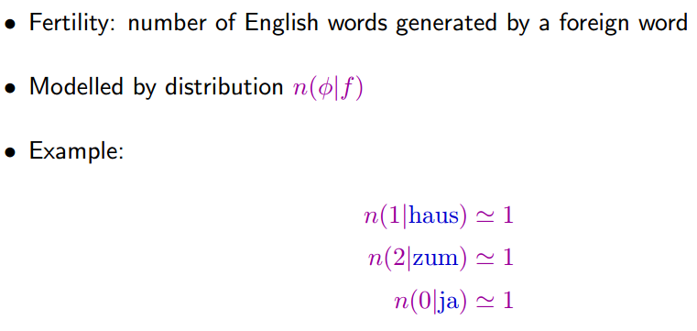
IBM Model 3: Fertility
For each foreign word f , this probability distribution indicates how many φ = 0, 1, 2, ... output words it usually translates to
Pilani Campus
Notes:
we have not explicitly modeled how many words are generated from each input word.

Slide 50
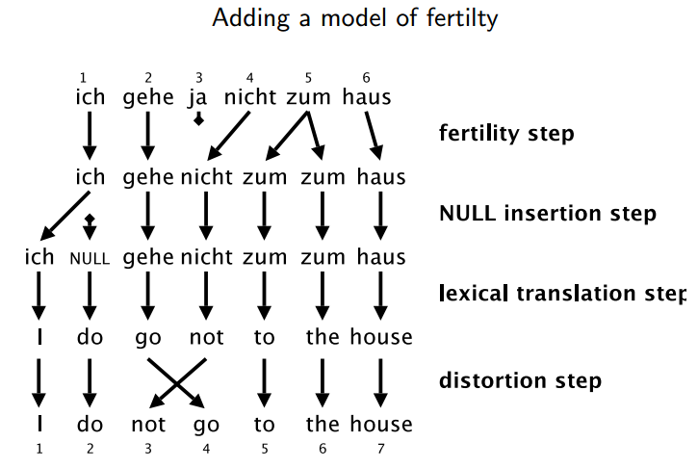
IBM Model 3: Fertility
Pilani Campus

Slide 51
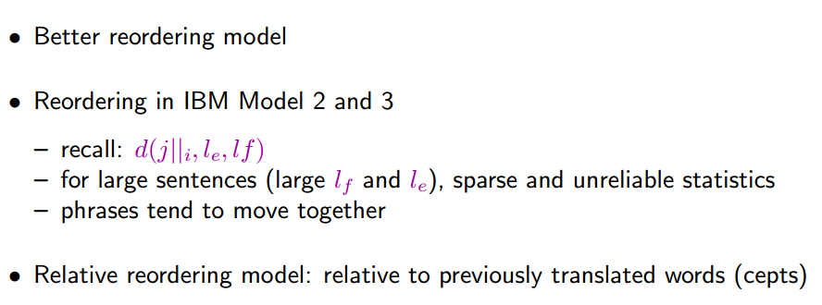
IBM Model 4
Pilani Campus

Slide 52
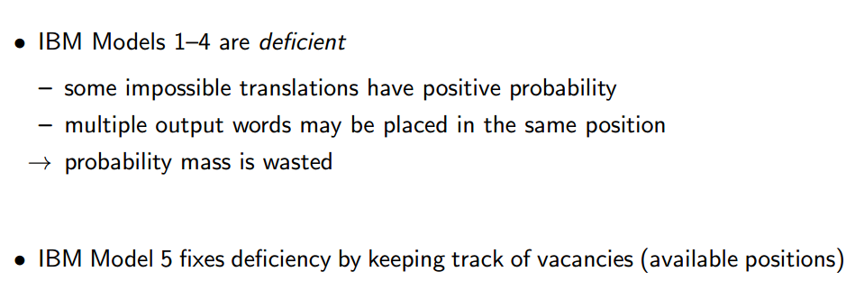
IBM Model 5
Pilani Campus

Slide 53
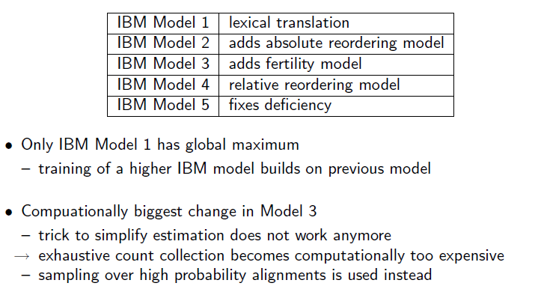
Higher IBM Models
Pilani Campus

Slide 54
Take home message
CLIR requires one extra step where either documents have to be translated into query space or viceversa.
In general most common ways for translation are rule based or statistical methods.
IBM Model1 is a statistical word based translation.
Pilani Campus

Slide 55
Take home message
IBM Models were the pioneering models in statistical machine translation
Introduced important concepts – generative model – EM training – reordering models
Only used for niche applications as translation model
Pilani Campus

